Slide 1
Presentation on Beam scanning ,Horizontal scanning & Vertical scanning

Slide 2
Presented To: Name : Md.Imran Hossain Assistant professor Department of ICT Comilla university Presented By: Name : Mumthahina khondaker ID:11809016 Department of ICT Comilla university

Slide 3
Outline:
What is scanning?
Beam scanning
Horizontal scanning
Vertical scanning
Interlaced scanning

Slide 4
What is scanning?
It’s a important process carried out in a television system in order to obtain continuous frame and provides motion of picture .
The picture is scanned both in the horizontal and vertical directions simultaneously.

Slide 5
Beam scanning
A image is scanned by an electron beam. The image to be transmitted is divided into a number of horizontal stripes or lines.

Slide 6
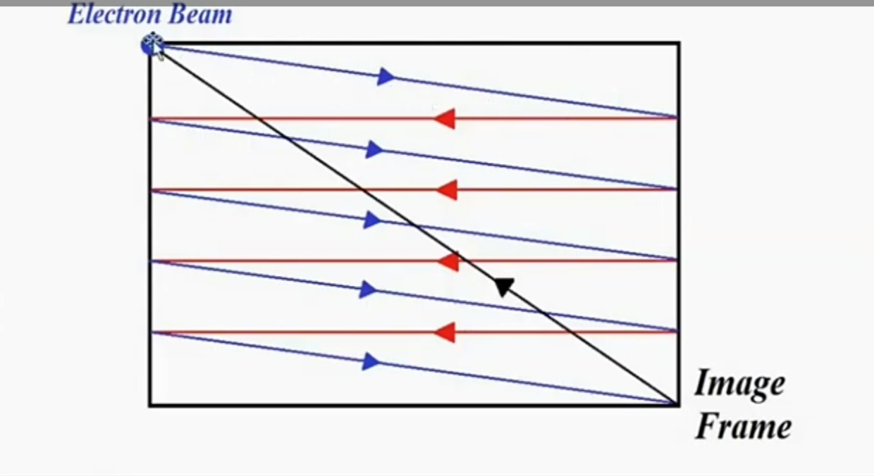
Horizontal and vertical scanning in Progressive scan:

Slide 7
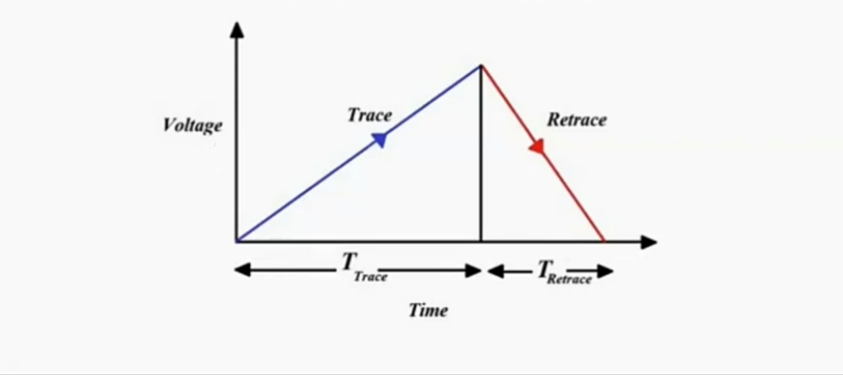
Sawtooth scanning waveform

Slide 8
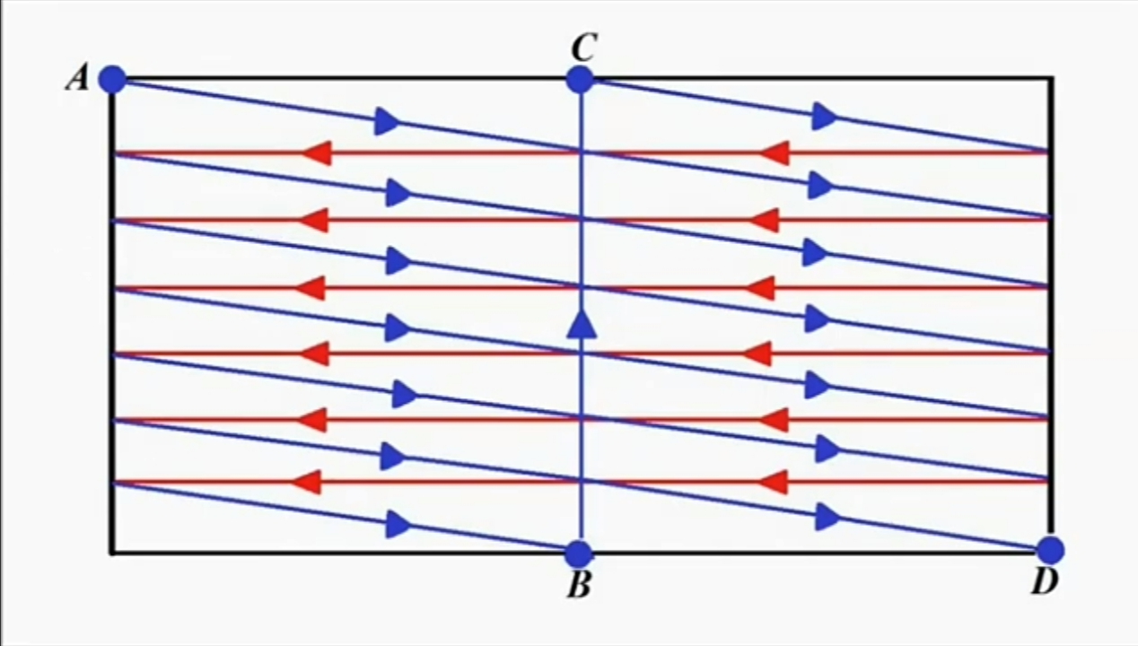
Interlaced scanning

